Slide 1

8th Grade Math: Pre-Algebra
Unit 11, Lesson 7 Barbie Bungee – Part 1 Volume 2, pg. 209

Slide 2


Benchmark
MA.8.DP.1.1
Given a set of real-world bivariate numerical data, construct a scatter plot or a line graph as appropriate for the context.
volume 2, pg. 209

Slide 3
Integrated Mathematical Thinking and Reasoning Standards
MA.K12.MTR.1.1 Actively participate in effortful learning both individually and collectively.
MA.K12.MTR.4.1 Engage in discussions that reflect on the mathematical thinking of self and others.
MA.K12.MTR.5.1 Use patterns and structure to help understand and connect mathematical concepts.
volume 2, pg. 209

Slide 4

Learning Target
I can collect data for an experiment.
volume 2, pg. 209

Slide 5

Warm-Up
volume 2, pg. 209

Slide 6
11.7.1 Warm-Up: Growth Mindset
Fear is a natural emotion but can be difficult to overcome when trying new things. The fear of trying something new sometimes fills us with doubt about our own abilities. Negative thoughts make giving up easy. However, with effort and perseverance, goals are achievable.
How does the statement display a growth mindset?
Describe a time when you were fearful before trying or starting something new but did it anyway.
How did it feel to overcome your fear?
volume 2, pg. 209

Slide 7

Activity
volume 2, pg. 210

Slide 8

11.7.2 Activity: Barbie Bungee – Part 1
Barbie and her friends are going bungee jumping, but safety is key! Conduct trials to help your team determine the number of rubber bands needed for Barbie to have a safe jump and thrilling bungee experience. Your teacher will explain the process.
Pre-Experiment
Measure the height of your Barbie in centimeters (cm).
volume 2, pg. 210

Slide 9
Represent three different risk levels by coloring in each arrow from the top of the jump to the lowest point Barbie’s head is from the ground.
Risk Level: Blue | Risk Level: Green | Risk Level: Red
Jump is safe but not thrilling. | Jump is thrilling and safe. | Jump is thrilling but a serious safety issue.
400 cm
400 cm
400 cm
200 cm
200 cm
200 cm
100 cm
100 cm
100 cm
Predict the maximum number of rubber bands needed for Barbie to achieve a jump in the green risk level.
volume 2, pg. 210

Slide 10
Data Collection
For the most accurate data, ensure that:
Barbie is jumping from the specified jump line.
A team member is ready to mark the lowest point from each jump.
All measurements are in centimeters.
All data from jump malfunctions are disregarded and the trial is repeated.
volume 2, pg. 210

Slide 11
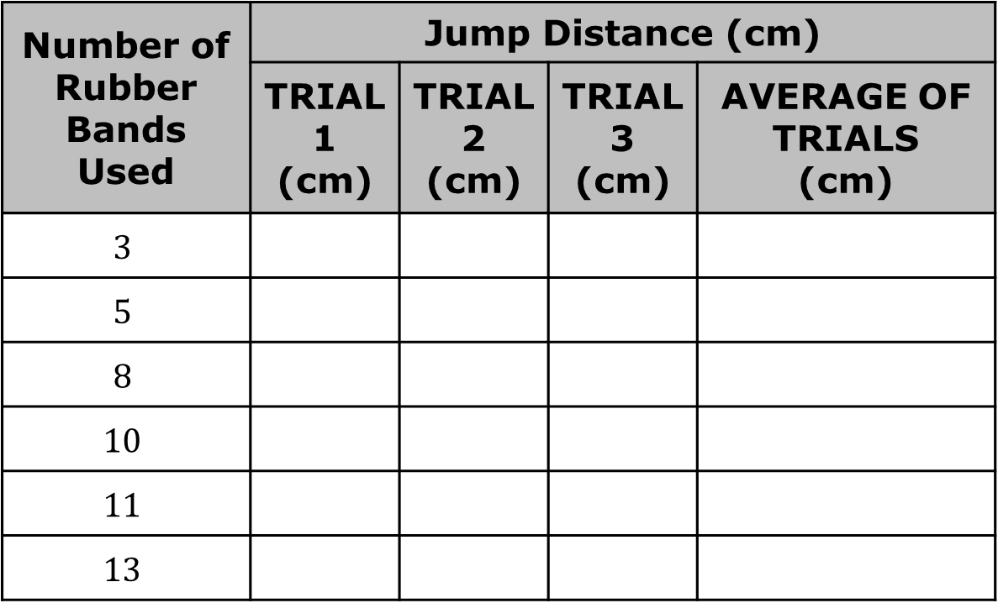
Perform three trials for each number of rubber bands with your team.
Record your results from each trial in the table.
Number of Rubber Bands Used | Jump Distance (cm)
 | TRIAL 1 (cm) | TRIAL 2 (cm) | TRIAL 3 (cm) | AVERAGE OF TRIALS (cm)
$$3$$
$$5$$
$$8$$
$$10$$
$$11$$
$$13$$
volume 2, pg. 210

Slide 12
Calculate the average of the trials for each number of rubber bands and record it in the table.
Consider the quantities being compared in this experiment.
Identify the two variables represented in the table.
Label the variables identified in Part A as independent (I) and dependent (D).
Explain how you determined the appropriate labels in Part B.
volume 2, pg. 210

Slide 13

Wrap-Up
volume 2, pg. 211

Slide 14
11.7.3 Wrap-Up: Growth Mindset
Reflect on your mindset today by placing a check next to the frequency that you demonstrated the behavior described in each statement.
Today I listened to my teammates and I was open to discussing how to complete the work. | Never Sometimes Usually Always
I thought of today’s lesson as a learning opportunity instead of rushing to complete the work. | Never Sometimes Usually Always
volume 2, pg. 211

Slide 15
Today I asked for clarification when I was unsure about something. | Never Sometimes Usually Always
I put as much effort as I possibly could into today’s work. | Never Sometimes Usually Always
Based on your responses, what will you do to improve or maintain a growth mindset tomorrow?
volume 2, pg. 211

